Slide 1
Converting Data to Information - Leveraging IIOT for Effective Power Systems Management

Slide 2
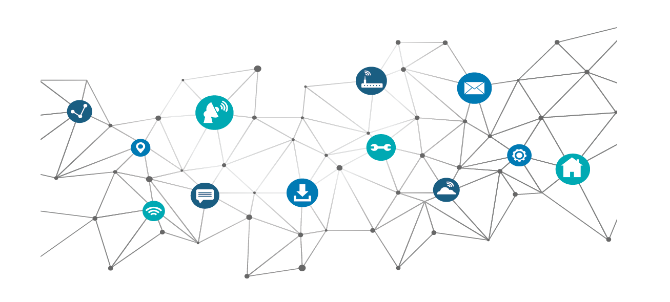
IIoT
The “Buzz” of IIoT Implementation
The persistent chatter & promise of IoT has spurred management of analysis opportunities only limited by imagination. As a consequence, either through executive push or departmental enthusiasm the implementation of IoT in critical facilities has become a perpetual conversation when considering capital budgets.
An IIoT strategy and the creation of a useful ecosystem of data includes:
Sound strategy and clear project goals & criteria for success
Existing and new hardware designed for interaction and scalability
Software aggregator that unifies and normalizes the data

Slide 3
Planning an IIoT Project
I want it all…
When pursuing an IoT project objectives should be clearly outlined:
Determination of the goal of the project
Energy reduction? Equipment maintenance? Forecasting?
We want it all. But remember, the depth and granularity of monitoring is directly proportionate to the cost
The data monitored is inherently low value – the value comes in the capabilities of the software of articulating what is monitored
Extensibility of the system
Ease of future additions

Slide 4
“AMMA”
Outline the Objectives
Leveraging IIoT is best viewed in degrees
Alarms
Emphasis on delivering critical exceptions and failures to the appropriate staff.
Less emphasis on monitoring and greater focus on dispatch to site and local troubleshooting
Benefits Lower upfront cost for deployment. Less training for NOC staff
Alarms

Slide 5
“AMMA”
Outline the Objectives
Leveraging IIoT is best viewed in degrees
Monitoring
Extending beyond alarms, monitoring is leveraging any data available in the equipment and supplementing it with other sensors to create a picture of the facility.
Benefits Detailed view allows for troubleshooting and qualifying issues at the site. Optimally, monitoring mitigates catastrophic issues at the site.
Monitoring
Alarms

Slide 6
“AMMA”
Outline the Objectives
Leveraging IIoT is best viewed in degrees
Management
Coupling monitoring with remote control and management of systems. This also allows for automated corrections
Benefits Ability to potentially remedy issues and / or leverage AI to have automated corrective routines
Management
Monitoring
Alarms

Slide 7
“AMMA”
Outline the Objectives
Leveraging IIoT is best viewed in degrees
Analytics
Utilizing current and trended data to extrapolate pending failures, cost analysis and capital projections.
Benefits Ultimately the biggest return – leveraging the cloud to determine savings & efficiency opportunities
Analytics
Management
Monitoring
Alarms

Slide 8
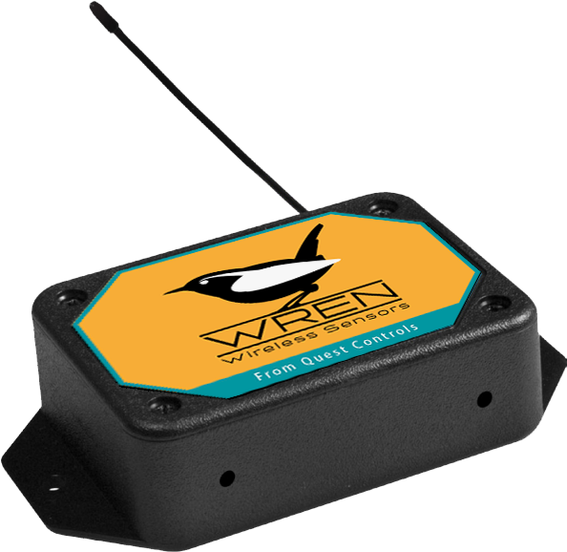
Leveraging Installed Technologies
I know the objectives, now what?
IIoT represents a culmination of synergy of many hardware & software datasets. A good software platform should be able to communicate with different systems & hardware and in turn normalize that data. Before installing a new solution, look at:
Leverage currently installed technology
Complement current systems
Overlay new technology
Complete Retrofit

Slide 9
Hardware Purchase Decisions
How do I collect the data?
A lot is already in the facility, when specifying or leveraging hardware, keeps these thoughts in mind:
Industry-standard open protocols
SNMP, MQTT, Modbus, BACnet, etc.
Scalability of the system
Can it accommodate aggressive polling? How many addresses can it accommodate?
Maintainability
Does it use batteries? Sensor calibration?
Software platform extensibility
Does the software provide the tools to model the data for you? Are there downstream and upstream interface methods?

Slide 10
Software
…Alright, I have my data, now what?
The thousands of points are communicating with the software. How do I extract actionable information? What am I looking for?
Data normalization
Intuitive data presentation & reporting
Ability for self-management & extensibility
Clear options for data retention & scaling
High availability

Slide 11
Visualization
…Alright, I have my data, now what?
Focus on the root of the project objectives. Software packages have lots of options
Rule of thumb – the more “unique” the graphics the longer it is to commission
Does the visualization have coherence? Does it go beyond the dazzle and present usable information?

Slide 12
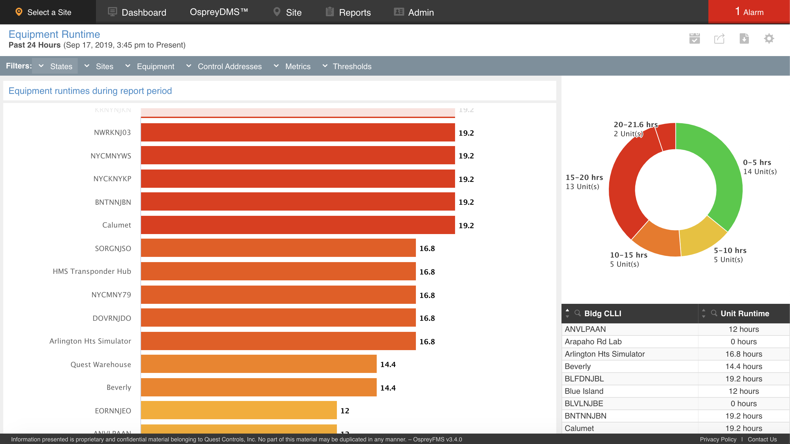
Reporting & Analyzation
…Alright, I have my data, now what?
The more qualified the incoming data, the more accurate the analysis. Overlaid conditions ensure quality information
Seek multi-layered user engagement
Flexibility is nice, but quality reports is best
Export & distribution options allow for more refinements and increased visibility

Slide 13
System Correlation
…Alright, I have my data, now what?
Different systems have surprising and sometimes unanticipated effects on one another.
Example above was indicated as a “rectifier failure”, however it was the unalarmed HVAC system that was the root cause
Correlating systems within the software assists in finding the root of any issue.

Slide 14
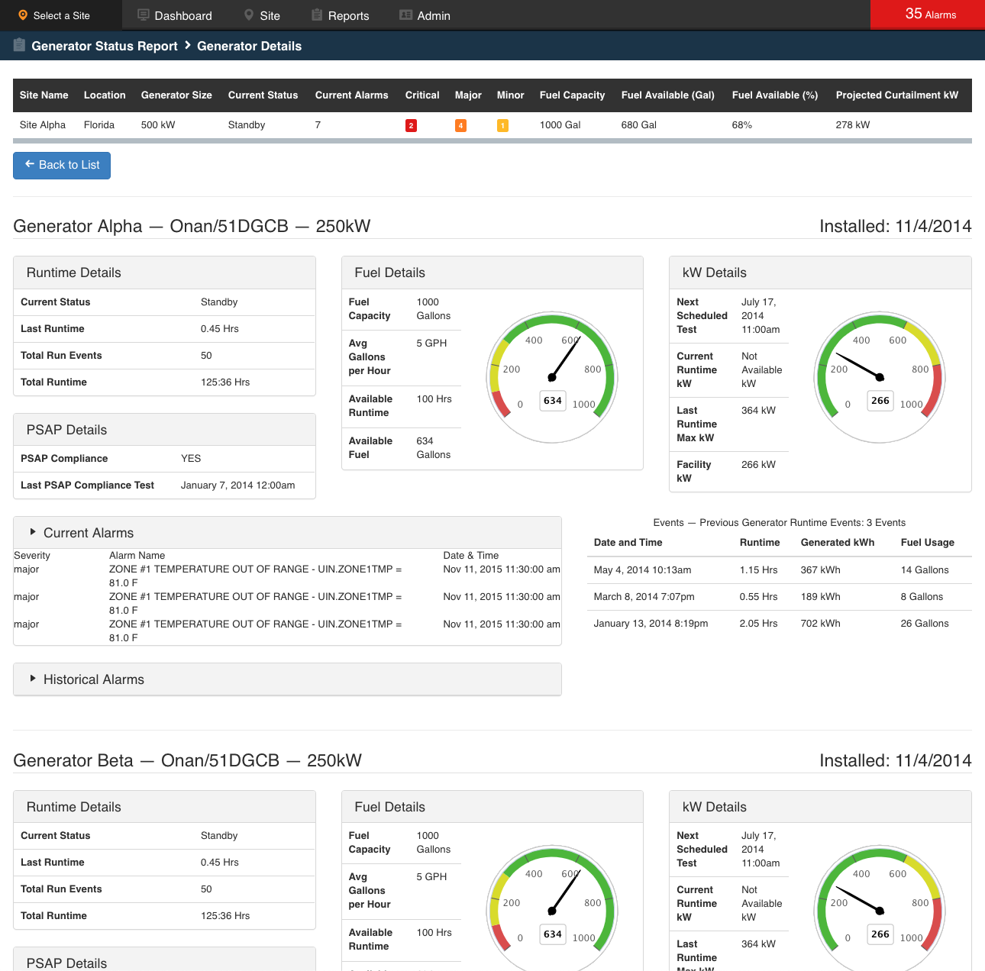
Automation
…Alright, I have my data, now what?
Automated corrective responses can sometimes be unnerving
Ideal automation would have the software coordinate the intelligence at the edge
Global actions continue to require oversight (Trust & confidence in the software comes with repeated successes)

Slide 15
Projections
…Alright, I have my data, now what?
Anticipate capital decisions, pending failures and weather events
Significant savings, also requires a commitment and confidence in the software

Slide 16
History / Trending
…Alright, I have my data, now what?
Software should have options for data retention & granularity
Reporting should continue to provide rapid retrieval for data up to 18 months old
Adjustable polling cycles

Slide 17
Commitment to Remedy
The software can only automate so much…
Your software platform can only adapt and adjust so far. Inevitably you will need to determine how you will respond to the provided information.
The level of data and analysis could be a game-changer. Planning & prioritization on that received data is tantamount.
Will you have the budget make those changes
Weigh out soft savings versus hard savings
Seek software that can assist in cost-modeling

Slide 18
User Engagement
Ultimately, how committed are you?
Even in the perfect implementation central to this is – what is your level of commitment?
How much flexibility is afforded to the staff not to comply to regulations?
How much time are you able to dedicate?
How much ongoing resources are you willing to dedicate? Staff. Money.
Is there buy-in from other potentially effected groups and management? E.g. Facilities. Power. Engineering. Planning.

Slide 19
Summary
Remember…
With your project remember these steps
Determine project objectives
Proper hardware planning
Leveraging installed technology
Proper software planning
Commitment to remedy

Slide 20
Thank you!

